Slide 1
Linux Kernel Architecture
From:
Pooja Dhamija
121034

Slide 2
Kernel Architecture Overview
User space
System call
Kernel space
Hardware
user

Slide 3
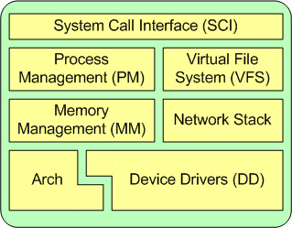
Anatomy of Linux Kernel

Slide 4
File System
To store information on the disk and updating and retrieving this information.
Accessed through system calls.
Types of files
1.Ordinary files
2. Directory files
3. Special files
4. FIFO Files
Structure of file systems
Boot Block Super Block Inode list Block list

Slide 5
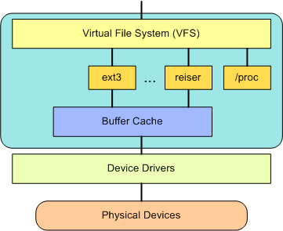
Virtual File System

Slide 6
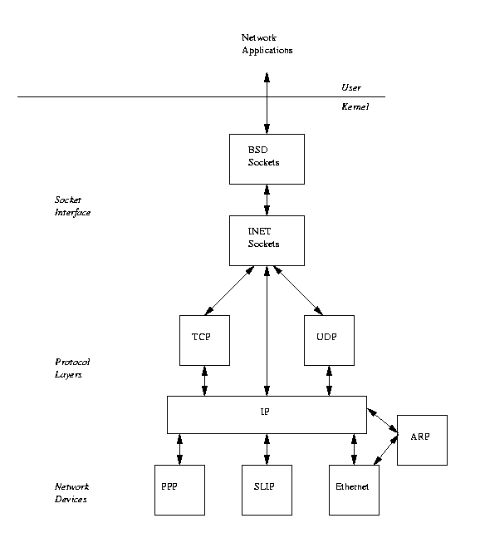
Networking

Slide 7
References
http://www.tldp.org/LDP/tlk/net/net.html
http://en.wikipedia.org/wiki/Linux_kernel
http://www.slideshare.net/tejabn91/linux-kernel-architecture?related=1
http://www.ibm.com/developerworks/library/l-linux-kernel/

Slide 8
Thank You

